Slide 1

ModelIt!
Student Lesson
The Invisible Plant Factory
How Plants Build Themselves from Thin Air and Sunlight
NGSS: MS-LS1-6
6th Grade
1/9

Slide 2
What You Will Learn Today
Learning Goals
* Explain how plants convert light energy, water, and carbon dioxide into glucose and oxygen
* Model how sunlight intensity, water availability, CO₂ concentration, and chlorophyll affect photosynthesis rates
* Describe photosynthesis as a chemical reaction that transforms energy and matter
* Connect photosynthesis to the global carbon cycle and energy flow in ecosystems
Key Vocabulary
Photosynthesis
The process plants use to convert light energy, CO₂, and water into glucose (food) and oxygen
Chlorophyll
The green pigment in plant cells that captures light energy to power photosynthesis
Glucose
A sugar molecule (C₆H₁₂O₆) that stores chemical energy — the product of photosynthesis
Carbon Dioxide (CO₂)
A gas in the atmosphere that plants absorb and use as a carbon source for building molecules
2/9

Slide 3
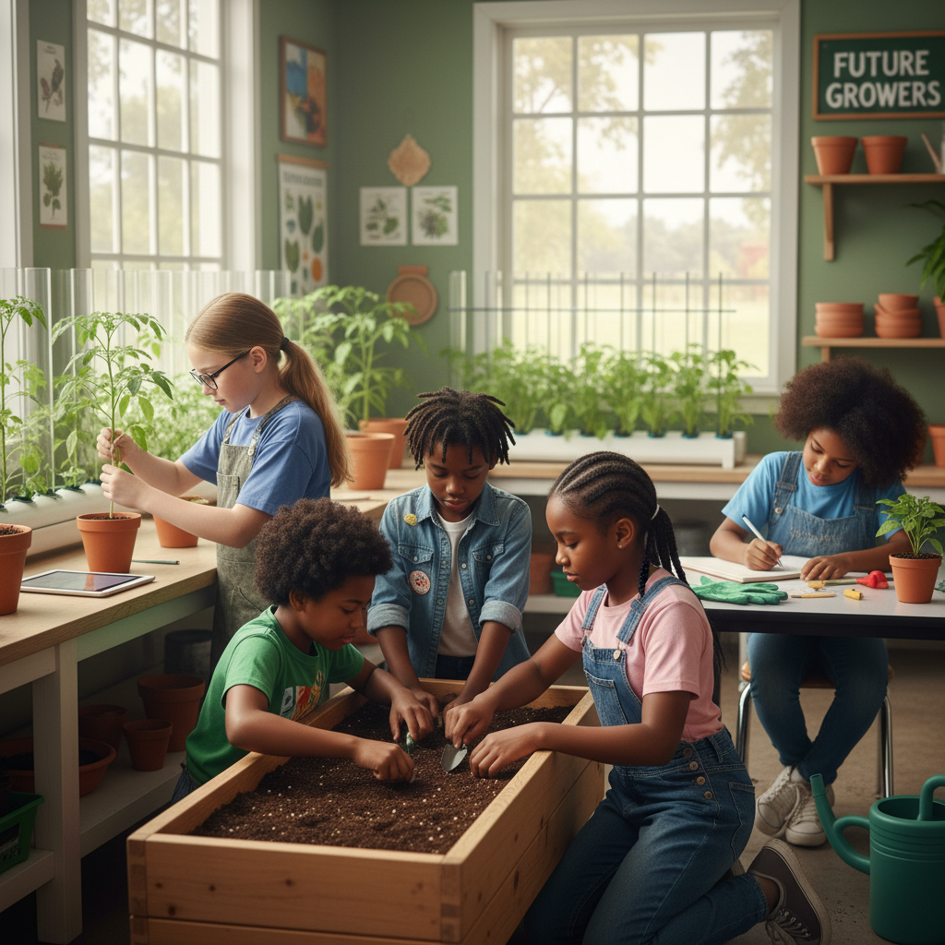
The Big Question
If plants make their own food from sunlight and air, where does the MASS of a giant tree actually come from?
How Plants Build Themselves from Thin Air and Sunlight. Today we'll build a MODEL to discover the answer!
3/9

Slide 4
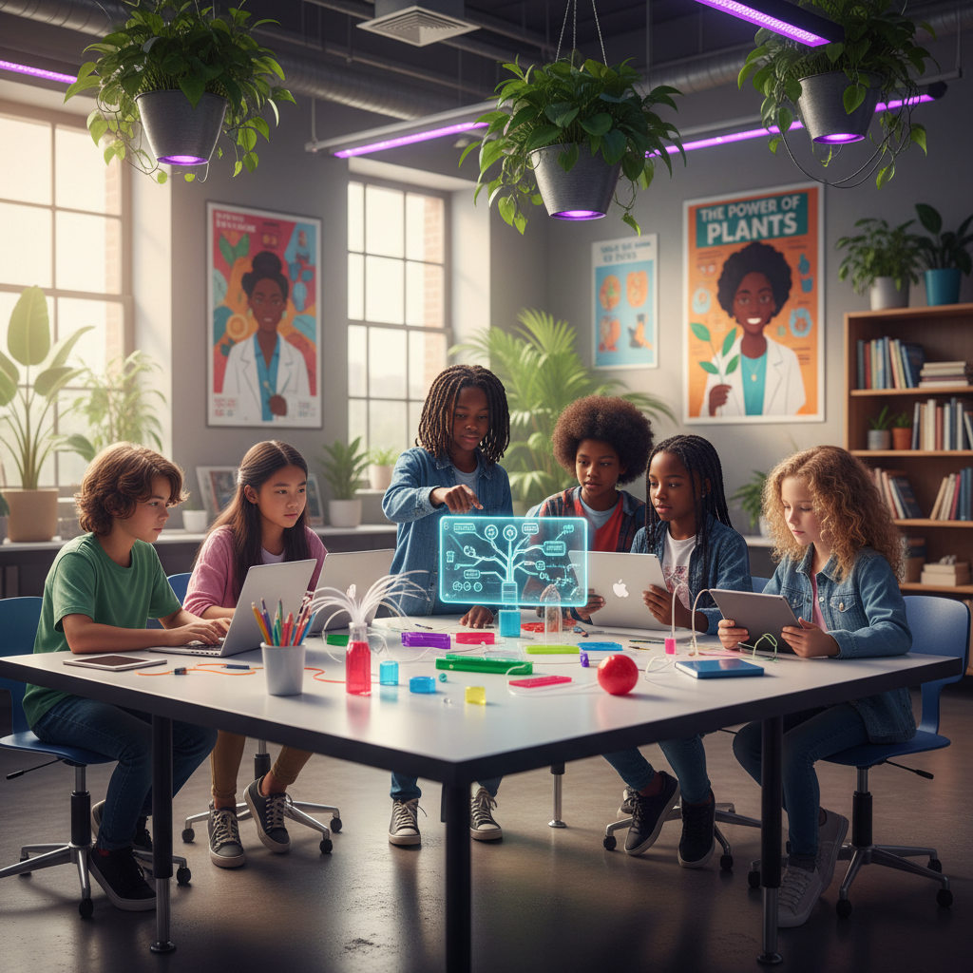
Today We Will Build a Model!
A model helps us understand complex systems!
1. LOCATE
Identify the COMPONENTS (parts) of the system
2. ESTABLISH
Connect them with RELATIONSHIPS (+ or -)
3. VISUALIZE
Build your model in ModelIt!
4. EVALUATE
Run SIMULATIONS to test scenarios
5. REVISE
Improve your model based on evidence
4/9

Slide 5
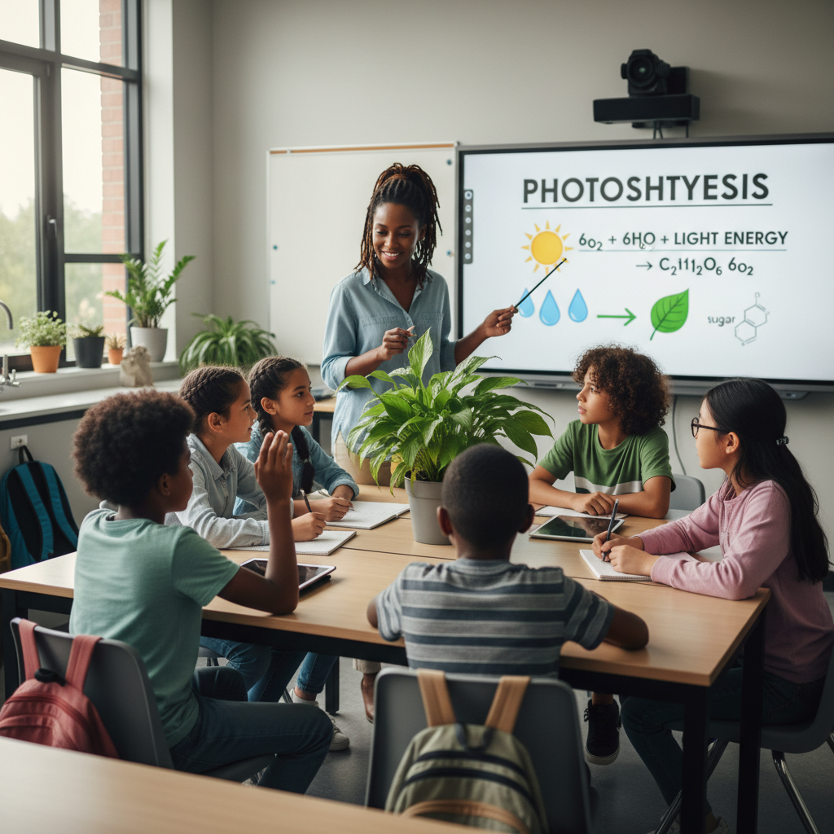
Activity 1: Sort the Components
Sort these components into EXTERNAL (inputs from outside) and INTERNAL (inside the system):
Your Components:
* Sunlight Intensity
* Water Availability
* CO₂ Concentration
* Chlorophyll Amount
Think: Which components can we control? Which happen on their own?
5/9

Slide 6
Activity 2: Connect with Arrows
Draw arrows to show HOW components affect each other:
(+) POSITIVE Relationship
When one goes UP, the other goes UP too
(-) NEGATIVE Relationship
When one goes UP, the other goes DOWN
Think About It:
When sunlight intensity increases, what happens to the rate of photosynthesis? What happens when CO₂ runs low — can the plant still make food?
6/9

Slide 7
Activity 3: Run the Simulation!
Test these scenarios in ModelIt!
Perfect Day
Set all inputs to moderate-high levels and observe glucose production
Cloudy Week
Lock Sunlight Intensity to 20% and observe how it affects the plant
Drought Stress
Set Water Availability to 10% while keeping other inputs normal
Watch the activity graphs change!
[ModelIt Platform Screenshot - Simulation Results Graph]
7/9

Slide 8
What Did We Discover?
Our Model Showed Us:
* Plants need ALL THREE inputs (sunlight, water, CO₂) — removing any one stops photosynthesis completely
* Most of a tree's mass comes from CARBON DIOXIDE in the air, not from the soil
* Photosynthesis is the reverse of cellular respiration — they're balanced opposite reactions
* More chlorophyll allows a plant to capture more light energy, increasing photosynthesis rate up to a saturation point
Answer: A giant tree's mass comes mostly from carbon dioxide in the AIR! During photosynthesis, plants pull CO₂ from the atmosphere and use light energy to rearrange the carbon atoms into glucose molecules. Those carbon atoms become the wood, bark, and leaves. A tree is literally built from air and sunlight — the soil mainly provides water and minerals!
8/9

Slide 9
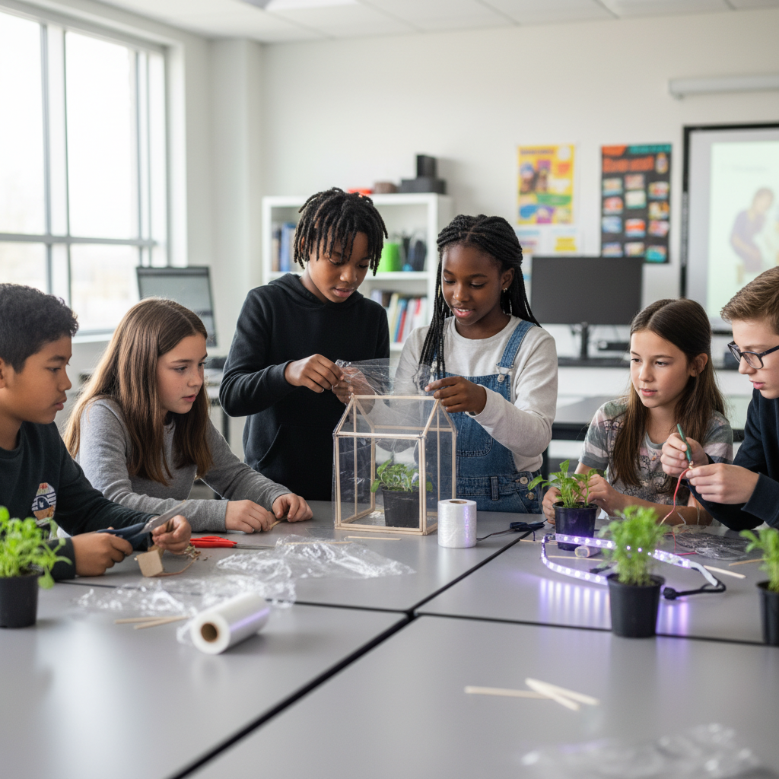
STEM Challenge: Design a Space Greenhouse
YOUR ENGINEERING MISSION
Design a greenhouse for a Mars colony that provides maximum food production by optimizing photosynthesis conditions in an environment with limited resources.
The Challenge:
NASA is planning a Mars colony and needs a self-sustaining greenhouse. Mars has 95% CO₂ atmosphere but only 43% of Earth's sunlight, limited water, and no soil. Your agricultural engineering team must design a greenhouse using your photosynthesis model evidence.
Think Like an Engineer:
* How will you provide enough light for photosynthesis on Mars where sunlight is weaker?
* With 95% CO₂ on Mars, is carbon dioxide still a limiting factor? What IS the limiting factor?
* How will you recycle water and nutrients in a closed system?
REAL CAREER CONNECTION: Botanists and Agricultural Engineers develop new crop varieties, design sustainable farming systems, and study how to grow food in extreme environments — including space. They earn $55,000–$110,000/year. The skills you're using TODAY are the same ones they use on the job!
9/9

